Slide 1


Database Management Systems
B+ Trees

Slide 2
Structure
Internal Nodes
Leaf Nodes
How is this an advantage over b-trees?

Slide 3
B+-Trees
Advantage of two different node types?
”I don’t want to leaf nodes to drop off from 50% capacity not totally empty because that is a totally waste space not totally full because space allow easy insertion”
Insertion and deletion?

Slide 4
B-Trees vs. B+-Trees
Keep data node and tree node separate
Inner node just store the pointer to other node while data only store in leaf nodes
- For B+-Trees we must go all the way down to the leaf node while for B-Trees we might find data in the middle
Why we use this seemingly more “complicated” structure?
It keeps data node from tree node (Isolation)
Larger branching factor, reduce the searching space faster: in B-Trees data node and tree node are stored in the same heap page for one entry pair but for B+-Trees not, in this case more tree factor can be stored in one heap page(like more index)
If we just want to traverse all the data, we just go through the last layer by a sorted linked list, which allows us scan all the data

Slide 5
Key Terms
K is the value being searched for / inserted / deleted
b is called the fanout
– What dictates this?
The size of heap page, decide the ultimate performance for B+-Tree.

Slide 6
B+ Tree Properties
The number of elements in a node is dictated by the degree of the tree (p):
Internal Nodes (children): ciel(p/2) → p
Exception: root
Minimum number of search keys?
Leaf nodes (keys): ciel(p/2)→ p
No limit (when just start a B+-tree)
The degree of the inner nodes and leaf nodes does not have to be the same
Why diff? (consider the structure, every node is stored in the heap page, pointer and search keys, the type of search key is the same as the type of columns that have been indexed) The former based on # of children and the latter based on # of keys. In practice, we want them to be as large as possible

Slide 7
Searching (recursive)
Function search(k, node): if node is a leaf
return node else
if k < k₀
return search(k, p₀) else if k > k_{q}
return search(k, p_{q}) else
Find value k_{i} such that k_{i} < k < k_{i+1}
return search(k, p_{i+1})

Slide 8
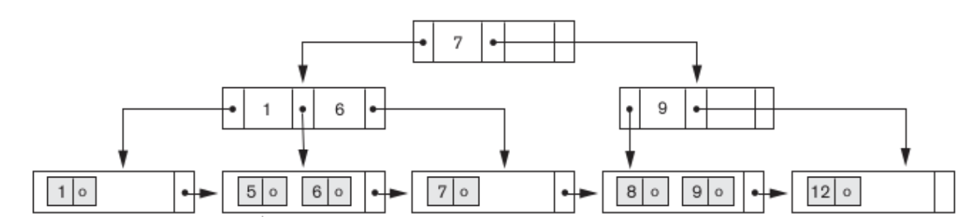
Search Example

Slide 9
Insertion
Search for the node where the new record should go If the target node is not full, add the record
else:
Make a new node that contains half the values of the old one
Insert the largest key of the new node into the parent If the parent is full:
Split the parent and add the middle key to its parent Repeat until a split is not needed
If the root needs to split:
Create a new root with one key and two pointers

Slide 10
Insertion
Insert a 3:

Slide 11
Insertion
Insert a 12:

Slide 12
Insertion
Insert a 9:

Slide 13
Insertion
Insert a 6:

Slide 14
Insertion (final)

Slide 16
Deletion
Search for the node where the new record should go
If the node is more than half full, remove entry and done
(deletionDirectly)
Else:
If sibling (with same parent) is more than half full, take an entry from it, update parent (deletionborrow)
Otherwise
Merge node with sibling (if the degree is large not simply remove) (merge)
Delete entry from parent of removed node
May cause parents to merge
Merging internal nodes:
Grab value from sibling and “push through”
Update pointers

Slide 17
Deletion
Delete 5:

Slide 18
Deletion
Delete 12:

Slide 19
Deletion
Delete 9:

Slide 20
Deletion (final)

Slide 22
Exercise
Using a btree with p_{inner} = 3 and p_{leaf} = 2, sketch the result of the insertion of the following values:
9, 4, 12, 7, 2, 6, 1, 3, 10
Repeat the above example with a btree with p_{inner} = 4 and ^{p}leaf ⁼ ³

Slide 23
Exercise
Using the btree (p_{inner} = 3 and p_{leaf} = 2)from the previous exercise, show the result of deleting the following values:
7, 3, 4, 10, 2
Repeat the above example with your p_{inner} = 4 and p_{leaf} = 3 tree

Slide 24
Indexing in SQL
What columns should we be indexing?
–Should we just index all columns?
What part of the query process is affected by the index?

Slide 25
SQL Example
CREATE INDEX name_idx on Student (lname);
Can include multiple columns as part of an index
–How does this affect the index structure?

Slide 26
Exercise
◼ Revisit your course tracking database. Decide what columns would be worthy of an index, and create them.

